Slide 1

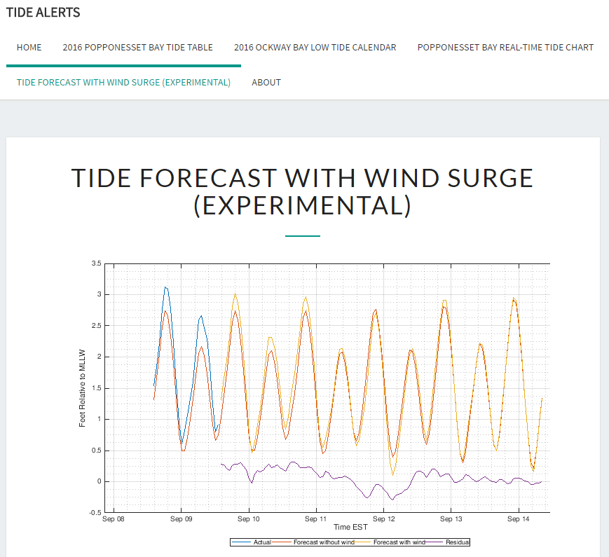
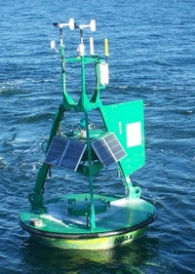
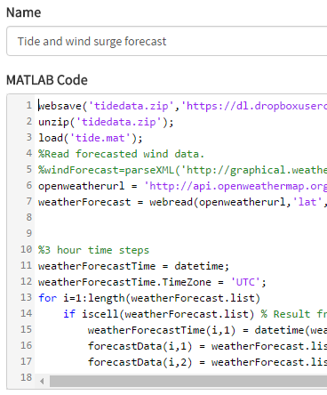
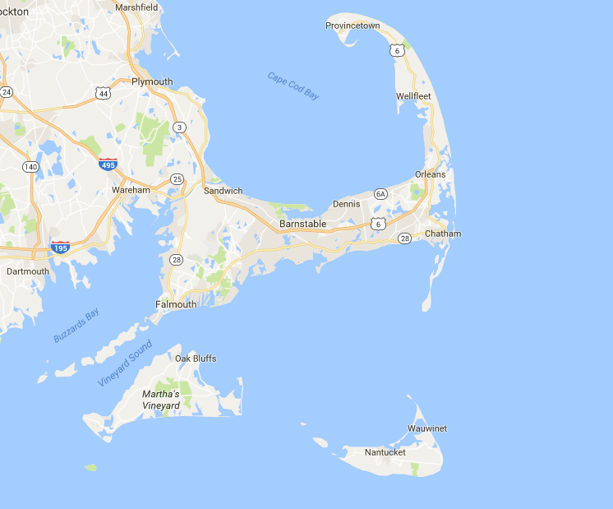

Recent tide level
Cloud database
NOAA wind History
NWS wind forecast
On-demand tide surge forecast
Deployment
Neural Network Machine Learning Algorithm
Historical wind and tide data
Tidal Coefficient Analysis and Neural Network Design and Training

